Slide 1
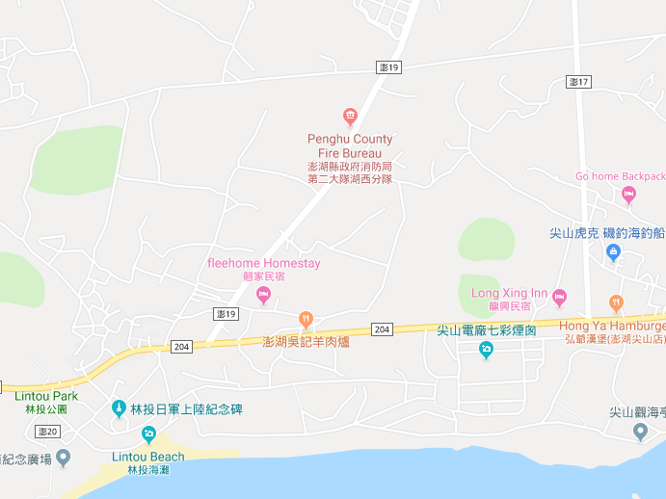

















Penghu County Huxi Township Lintou Village Evacuation Map
Disaster Prevention Information
Emergency Notification Unit
Penghu Emergency Operation Center TEL:06-9277619 Huxi TownshipEmergency Operation Center TEL:06-9921731 Aimen Police Station TEL:06-9210780 Huxi Fire Station TEL:06-9921119
Evacuation Principle
Flood:Stay away from low-lying area or go to evacuation shelter. Earthquake:Go to open space or evacuation shelter. Tsunami:Stay away from coastal low-lying area and take refuge in the nearby highland.
Evacuation Shelter
Name | Square
Area | 6,000 m²
Capacity | 1,500 people
Name | Highland
Area | 2,000 m²
Capacity | 500 people
Name | Lintou Community Activity Center
Area | 134 m²
Capacity | 33 people
Address | No. 13-1, Lintou, Huxi Township
TEL | 06-9921179
Made in Sep. 2025 by Huxi Township Office, Penghu County
Square
Huxi Fire Station
Highland
Lintou Village
Jianshan Power Station
Lintou Community
Activity Center
Legend | Labelling |  | Facility
 | Evacuation Route | Shelter for Flood | Indoor Evacuation Shelter | Park | Medical Facility
 | Flooded Area | Shelter for Earthquake | Outdoor Evacuation Shelter | Police Department
 | Continuous Monitored Area | Shelter for Tsunami | Helipad | Fire Department

