Slide 1
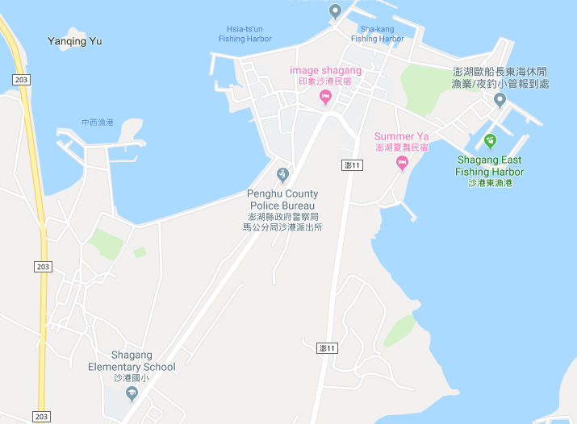

















Penghu County Huxi Township Shagang Village Evacuation Map
Disaster Prevention Information
Emergency Notification Unit
Penghu Emergency Operation Center TEL:06-9277619 Huxi TownshipEmergency Operation Center TEL:06-9921731 Shagang Police Station TEL:06-9210779 Huxi Fire Station TEL:06-9921119
Evacuation Principle
Flood:Stay away from low-lying area or go to evacuation shelter. Earthquake:Go to open space or evacuation shelter. Tsunami:Stay away from coastal low-lying area and take refuge in the nearby highland.
Evacuation Shelter
Name | Shagang Elementary School
Area | 400 m²
Capacity | 100 people
Address | No. 75, Dingwan, Huxi Township
TEL | 06-9210087
Name | Shagang Community Activity Center
Area | 520 m²
Capacity | 129 people
Address | No. 75-1, Shagang, Huxi Township
TEL | 06-9213663
Made in Sep. 2025 by Huxi Township Office, Penghu County
Shagang Community Activity Center
Shagang Police Station
Shagang Village
Shagang Elementary School
Legend | Labelling |  | Facility
 | Evacuation Route | Shelter for Flood | Indoor Evacuation Shelter | Park | Medical Facility
 | Flooded Area | Shelter for Earthquake | Outdoor Evacuation Shelter | Police Department
 | Continuous Monitored Area | Shelter for Tsunami | Helipad | Fire Department

