Slide 1
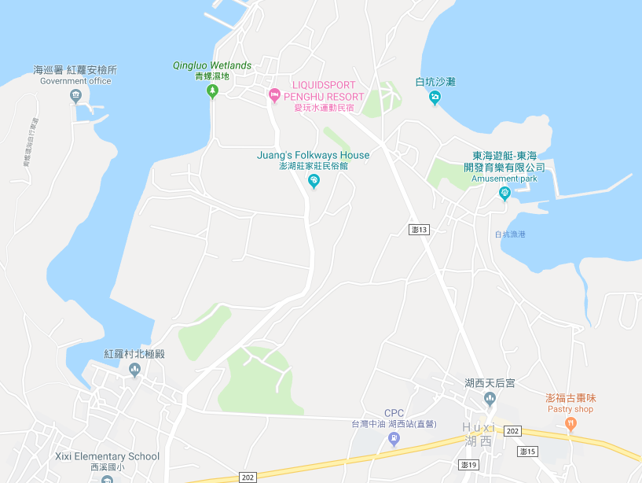



















Penghu County Huxi Township Qingluo Village Evacuation Map
Disaster Prevention Information
Emergency Notification Unit
Penghu Emergency Operation Center TEL:06-9277619 Huxi TownshipEmergency Operation Center TEL:06-9921731 Huxi Police Station TEL:06-9921022 Huxi Fire Station TEL:06-9921119
Evacuation Principle
Flood:Stay away from low-lying area or go to evacuation shelter. Earthquake:Go to open space or evacuation shelter. Tsunami:Stay away from coastal low-lying area and take refuge in the nearby highland.
Evacuation Shelter
Name | Huxi Junior High School
Area | 600 m²
Capacity | 150 people
Address | No. 43-1, Huxi, Huxi Township
TEL | 06-9921929
Name | Qingluo Community Activity Center
Area | 150 m²
Capacity | 35 people
Address | No. 1-1, Qingluo, Huxi Township
TEL | 06-9921029
Made in Sep. 2025 by Huxi Township Office, Penghu County
Qingluo Community Activity Center
Qingluo Village
Huxi Junior High School
Huxi Police Station
Legend | Labelling |  | Facility
 | Evacuation Route | Shelter for Flood | Indoor Evacuation Shelter | Park | Medical Facility
 | Flooded Area | Shelter for Earthquake | Outdoor Evacuation Shelter | Police Department
 | Continuous Monitored Area | Shelter for Tsunami | Helipad | Fire Department

