Slide 1
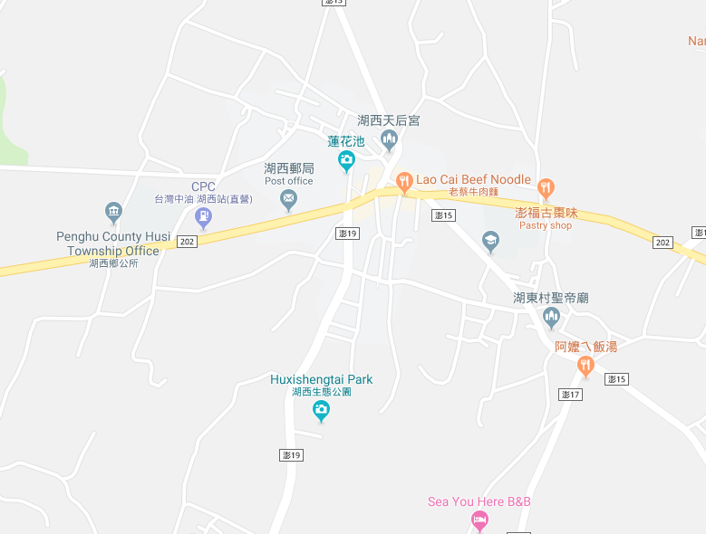
























Penghu County Huxi Township Hudong Village Evacuation Map
Disaster Prevention Information
Emergency Notification Unit
Penghu Emergency Operation Center TEL:06-9277619 Huxi Township Emergency Operation Center TEL:06-9921731 Huxi Police Station TEL:06-9921022 Huxi Fire Station TEL:06-9921119
Evacuation Principle
Flood:Stay away from low-lying area or go to evacuation shelter. Earthquake:Go to open space or evacuation shelter. Tsunami:Stay away from coastal low-lying area and take refuge in the nearby highland.
Evacuation Shelter
Name | Hudong Community Activity Center
Area | 150 m²
Capacity | 35 people
Address | No. 23-1, Hudong, Huxi Township
TEL | 06-9921034
Name | Huxi Junior High School
Area | 600 m²
Capacity | 150 people
Address | No. 43-1, Huxi, Huxi Township
TEL | 06-9921929
Name | Square
Area | 6,000 m²
Capacity | 1,500 people
Made in Sep. 2025 by Huxi Township Office, Penghu County
Huxi Police Station
Huxi Junior High School
Huxi Township Public Health Center
Hudong Community Activity Center
Square
Hudong Village
Legend | Labelling |  | Facility
 | Evacuation Route | Shelter for Flood | Indoor Evacuation Shelter | Park | Medical Facility
 | Flooded Area | Shelter for Earthquake | Outdoor Evacuation Shelter | Police Department
 | Continuous Monitored Area | Shelter for Tsunami | Helipad | Fire Department

