Slide 1
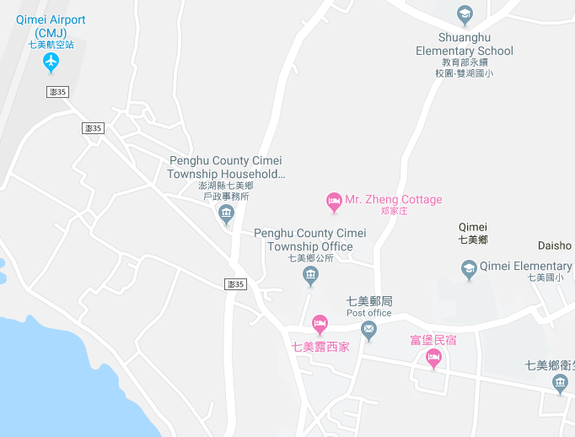



















Penghu County Qimei Township Pinghe Village Evacuation Map
Disaster Prevention Information
Emergency Notification Unit
Penghu Emergency Operation Center TEL:06-9277619 Qimei Township Emergency Operation Center TEL:06-9971007 Qimei Police Station TEL:06-9971001 Qimei Fire Station TEL:06-9971171
Evacuation Principle
Flood:Stay away from low-lying area or go to evacuation shelter. Earthquake:Go to open space or evacuation shelter. Tsunami:Stay away from coastal low-lying area and take refuge in the nearby highland.
Evacuation Shelter
Name | Pinghe Community Activity Center
Area | 116 m²
Capacity | 25 people
Address | No. 23-1, Pinghe, Qimei Township
TEL | 06-9971009
Name | Square
Area | 2,000 m²
Capacity | 500 people
Made in March 2024 by Qimei Township Office, Penghu County
Qimei Airport
Pinghe Community Activity Center
Pinghe Village
Square
Qimei Police Station
Legend | Labelling |  | Facility
 | Evacuation Route | Shelter for Flood | Indoor Evacuation Shelter | Park | Medical Facility
 | Flooded Area | Shelter for Earthquake | Outdoor Evacuation Shelter | Police Department
 | Continuous Monitored Area | Shelter for Tsunami | Helipad | Fire Department

