Slide 1
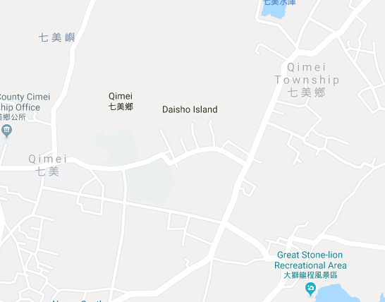


















Penghu County Qimei Township Zhonghe Village Evacuation Map
Disaster Prevention Information
Emergency Notification Unit
Penghu Emergency Operation Center TEL:06-9277619 Qimei Township Emergency Operation Center TEL:06-9971007 Qimei Police Station TEL:06-9971001 Qimei Fire Station TEL:06-9971171
Evacuation Principle
Flood:Stay away from low-lying area or go to evacuation shelter. Earthquake:Go to open space or evacuation shelter. Tsunami:Stay away from coastal low-lying area and take refuge in the nearby highland.
Evacuation Shelter
Name | Qimei Community Activity Center
Area | 416 m²
Capacity | 100 people
Address | No.55, Zhonghe, Qimei Township
TEL | 06-9971007
Name | Square
Area | 2,000 m2
Capacity | 500 people
Name | Qimei Junior High School
Area | 600 m²
Capacity | 150 people
Address | No.4, Zhonghe, Qimei Township
TEL | 06-9971019
Name | Qimei Elementary School
Area | 91 m²
Capacity | 20 people
Address | No.1, Zhonghe, Qimei Township
TEL | 06-9971003
Name | Zhonghe Community Activity Center
Area | 108 m²
Capacity | 25 people
Address | No.41-1, Zhonghe, Qimei Township
TEL | 06-9971006
Made in March 2024 by Qimei Township Office, Penghu County
Zhonghe Village
Qimei Elementary School
Zhongzheng Park
Qimei Junior
High School
Zhonghe Community Activity Center
Qimei Township Public Health Center
Square
Qimei Community Activity Center
Legend | Labelling |  | Facility
 | Evacuation Route | Shelter for Flood | Indoor Evacuation Shelter | Park | Medical Facility
 | Flooded Area | Shelter for Earthquake | Outdoor Evacuation Shelter | Police Department
 | Continuous Monitored Area | Shelter for Tsunami | Helipad | Fire Department

