Slide 1
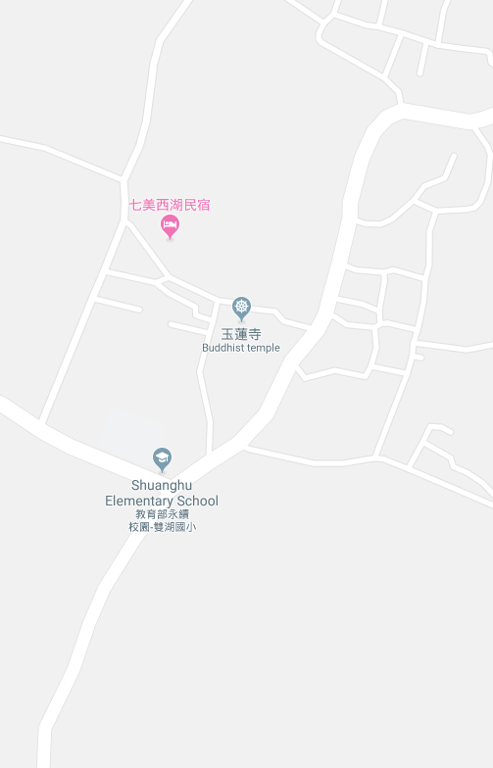















Penghu County Qimei Township Xihu Village Evacuation Map
Disaster Prevention Information
Emergency Notification Unit
Penghu Emergency Operation Center TEL:06-9277619 Qimei Township Emergency Operation Center TEL:06-9971007 Qimei Police Station TEL:06-9971001 Qimei Fire Station TEL:06-9971171
Evacuation Principle
Flood:Stay away from low-lying area or go to evacuation shelter. Earthquake:Go to open space or evacuation shelter. Tsunami:Stay away from coastal low-lying area and take refuge in the nearby highland.
Evacuation Shelter
Name | Xihu Community Activity Center
Area | 98 m²
Capacity | 20 people
Address | No. 38, Xihu, Qimei Township
TEL | 06-9971012
Name | Square
Area | 2,000 m²
Capacity | 500 people
Name | Shuanghu Elementary School
Area | 170 m²
Capacity | 40 people
Address | No. 9, Xihu, Qimei Township
TEL | 06-9971018
Made in March 2024 by Qimei Township Office, Penghu County
Square
Xihu Community Activity Center
Shuanghu Elementary School
Xihu Village
Legend | Labelling |  | Facility
 | Evacuation Route | Shelter for Flood | Indoor Evacuation Shelter | Park | Medical Facility
 | Flooded Area | Shelter for Earthquake | Outdoor Evacuation Shelter | Police Department
 | Continuous Monitored Area | Shelter for Tsunami | Helipad | Fire Department

