Slide 1
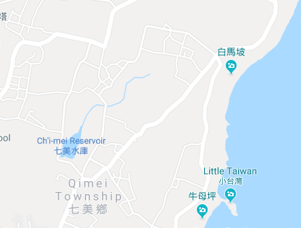

















Penghu County Qimei Township Donghu Village Evacuation Map
Disaster Prevention Information
Emergency Notification Unit
Penghu Emergency Operation Center TEL:06-9277619 Qimei Township Emergency Operation Center TEL:06-9971007 Qimei Police Station TEL:06-9971001 Qimei Fire Station TEL:06-9971171
Evacuation Principle
Flood:Stay away from low-lying area or go to evacuation shelter. Earthquake:Go to open space or evacuation shelter. Tsunami:Stay away from coastal low-lying area and take refuge in the nearby highland.
Evacuation Shelter
Name | Highland
Area | 4,000 m²
Capacity | 1,000 people
Name | Donghu Community Activity Center
Area | 142 m²
Capacity | 35 people
Address | No. 39-1, Donghu, Qimei Township
TEL | 06-9971013
Made in March 2024 by Qimei Township Office, Penghu County
Donghu Village
Highland
Donghu Community Activity Center
Legend | Labelling |  | Facility
 | Evacuation Route | Shelter for Flood | Indoor Evacuation Shelter | Park | Medical Facility
 | Flooded Area | Shelter for Earthquake | Outdoor Evacuation Shelter | Police Department
 | Continuous Monitored Area | Shelter for Tsunami | Helipad | Fire Department

