Slide 1
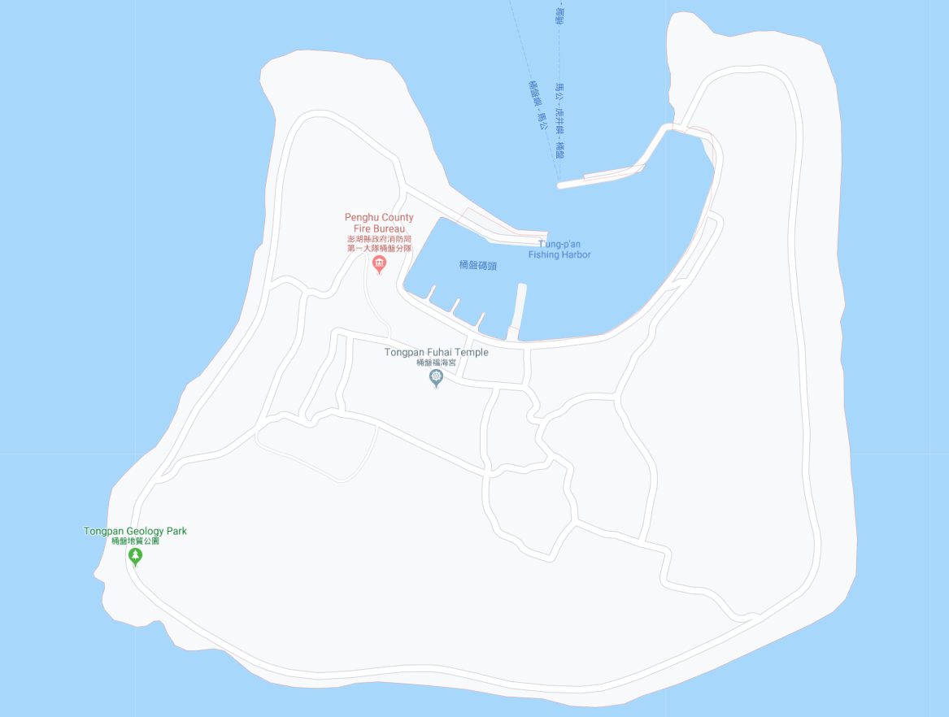




















Penghu County Magong City Tongpan Village Evacuation Map
Disaster Prevention Information
Emergency Notification Unit
Penghu Emergency Operation Center TEL:06-9277619 Magong City Emergency Operation Center TEL:06-9272173 Tongpan Police Station TEL:06-9291270 Tongpan Fire Station TEL:06-9291267
Evacuation Principle
Flood:Stay away from low-lying area or go to evacuation shelter. Earthquake:Go to open space or evacuation shelter. Tsunami:Stay away from coastal low-lying area and take refuge in the nearby highland.
Evacuation Shelter
Name | Highland
Area | 2,000 m²
Capacity | 500 people
Name | Tongoan Community Activity Center
Area | 93 m²
Capacity | 20 people
Address | No. 31-2, Tongpan, Magong City
TEL | 06-9291250
Name | Tongpan Fuhai Temple
Area | 450 m²
Capacity | 110 people
Address | No. 29, Tongpan, Magong City
TEL | 06-9291279
Made in March 2023 by Magong City Office, Penghu County
Tongpan Police Station
Tongpan Fire Station
Tongpan Fuhai Temple
Helipad
Tongpan Public Health Center
Tongoan Community Activity Center
Tongpan Village
Highland
Legend | Labelling |  | Facility
 | Evacuation Route | Shelter for Flood | Indoor Evacuation Shelter | Park | Medical Facility
 | Flooded Area | Shelter for Earthquake | Outdoor Evacuation Shelter | Police Department
 | Continuous Monitored Area | Shelter for Tsunami | Helipad | Fire Department

