Slide 1
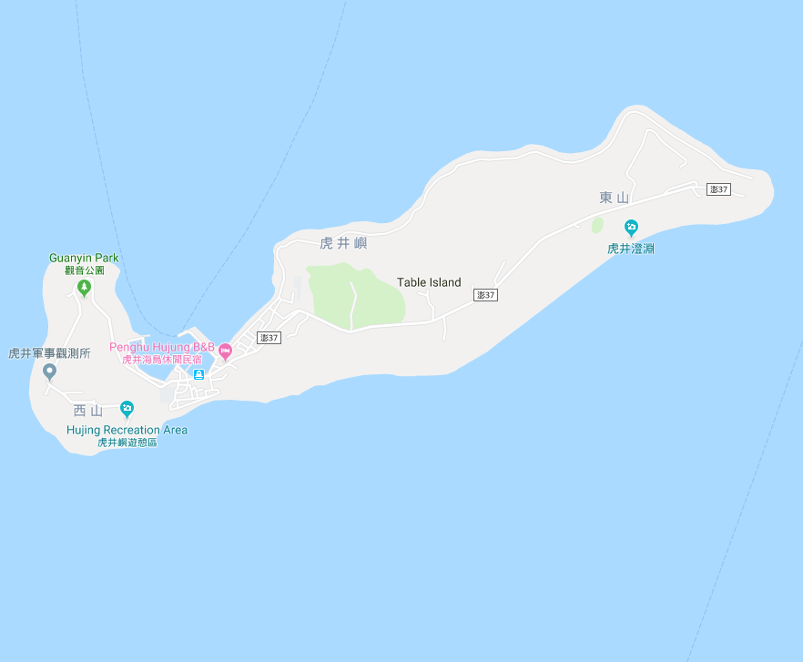




















Penghu County Magong City Hujing Village Evacuation Map
Disaster Prevention Information
Emergency Notification Unit
Penghu Emergency Operation Center TEL:06-9277619 Magong City Emergency Operation Center TEL:06-9272173 Hujing Police Station TEL:06-9291112 Hujing Fire Station TEL:06-9291226
Evacuation Principle
Flood:Stay away from low-lying area or go to evacuation shelter. Earthquake:Go to open space or evacuation shelter. Tsunami:Stay away from coastal low-lying area and take refuge in the nearby highland.
Evacuation Shelter
Name | Hujing Community Activity Center
Area | 566 m²
Capacity | 140 people
Address | No. 9-2, Hujing, Magong City
TEL | 06-9291012
Name | Highland A
Area | 4,000m²
Capacity | 1,000 people
Name | Highland B
Area | 4,000m²
Capacity | 1,000 people
Made in March 2023 by Magong City Office, Penghu County
Highland A
Hujing Village
Hujing Public Health Center
Hujing Fire Station
Helipad
Hujing Police Station
Highland B
Hujing Community
Activity Center
Legend | Labelling |  | Facility
 | Evacuation Route | Shelter for Flood | Indoor Evacuation Shelter | Park | Medical Facility
 | Flooded Area | Shelter for Earthquake | Outdoor Evacuation Shelter | Police Department
 | Continuous Monitored Area | Shelter for Tsunami | Helipad | Fire Department

