Slide 1
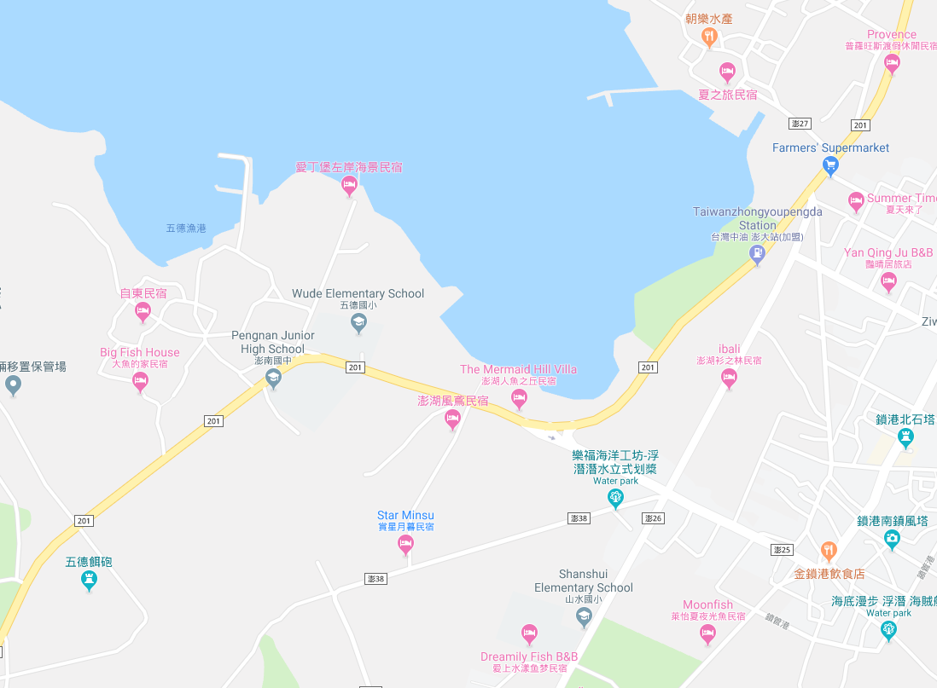




















Penghu County Magong City Tiexian Village Evacuation Map
Disaster Prevention Information
Emergency Notification Unit
Penghu Emergency Operation Center TEL:06-9277619 Magong City Emergency Operation Center TEL:06-9272173 Suogang Police Station TEL:06-9951024 Pengnan Fire Station TEL:06-9950119
Evacuation Principle
Flood:Stay away from low-lying area or go to evacuation shelter. Earthquake:Go to open space or evacuation shelter. Tsunami:Stay away from coastal low-lying area and take refuge in the nearby highland.
Evacuation Shelter
Name | Highland
Area | 3,000 m²
Capacity | 750 people
Name | Shanshui Elementary School
Area | 1,000 m²
Capacity | 250 people
Address | No. 140, Shanshui, Magong City
TEL | 06-9951004
Name | Tiexian Community Activity Center
Area | 460 m²
Capacity | 115 people
Address | No. 4-5, Tiexian, Magong City
TEL | 06-9951011
Made in March 2023 by Magong City Office, Penghu County
Tiexian Village
Tiexian Community Activity Center
The second Health Center of Mangong City
Pengnan Fire Station
Suogang Police Station
Highland
Shanshui Elementary School
Legend | Labelling |  | Facility
 | Evacuation Route | Shelter for Flood | Indoor Evacuation Shelter | Park | Medical Facility
 | Flooded Area | Shelter for Earthquake | Outdoor Evacuation Shelter | Police Department
 | Continuous Monitored Area | Shelter for Tsunami | Helipad | Fire Department

