Slide 1
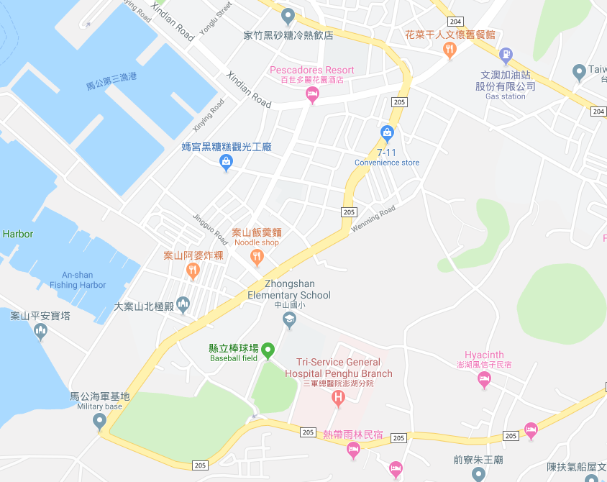



















Penghu County Magong City Anshan Village Evacuation Map
Disaster Prevention Information
Emergency Notification Unit
Penghu Emergency Operation Center TEL:06-9277619 Magong City Emergency Operation Center TEL:06-9272173 Wenao Police StationTEL:06-9214622 Magong Fire Station TEL:06-9272137
Evacuation Principle
Flood:Stay away from low-lying area or go to evacuation shelter. Earthquake:Go to open space or evacuation shelter. Tsunami:Stay away from coastal low-lying area and take refuge in the nearby highland.
Evacuation Shelter
Name | Zhongshan Elementary School
Area | 437 m²
Capacity | 108 people
Address | No. 25-6, Anshan, Magong City
TEL | 06-9211342
Name | Penghu County Baseball Stadium
Area | 1,600m²
Capacity | 400people
TEL | 06-9272803
Name | Anshan Community Activity Center
Area | 220 m²
Capacity | 55 people
Address | No. 51-20, Anshan, Magong City
TEL | 06-9212700
Name | Labor Recreation Center
Area | 2,560m²
Capacity | 640people
Address | No. 160, Daxian St., Magong City
TEL | 06-9274400
Name | Penghu County Baseball Stadium Square
Area | 2,000 m²
Capacity | 500 people
Made in March 2023 by Magong City Office, Penghu County
Anshan Village
Labor Recreation Center
Anshan Community Activity Center
Zhongshan Elementary School
Penghu County Baseball Stadium Square
Tri-Service General Hospital
Penghu Branch
Penghu County Baseball Stadium
Legend | Labelling |  | Facility
 | Evacuation Route | Shelter for Flood | Indoor Evacuation Shelter | Park | Medical Facility
 | Flooded Area | Shelter for Earthquake | Outdoor Evacuation Shelter | Police Department
 | Continuous Monitored Area | Shelter for Tsunami | Helipad | Fire Department

