Slide 1
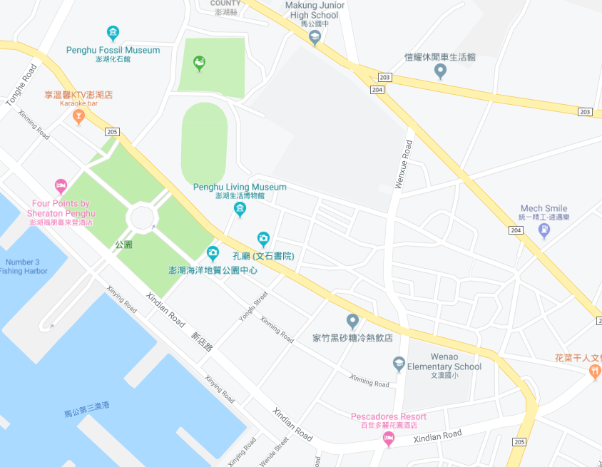

















Penghu County Magong City Xiwen Village Evacuation Map
Disaster Prevention Information
Emergency Notification Unit
Penghu Emergency Operation Center TEL:06-9277619 Magong City Emergency Operation Center TEL:06-9272173 Wenao Police Station TEL:06-9214622 Magong Fire Station TEL:06-9272137
Evacuation Principle
Flood:Stay away from low-lying area or go to evacuation shelter. Earthquake:Go to open space or evacuation shelter. Tsunami:Stay away from coastal low-lying area and take refuge in the nearby highland.
Evacuation Shelter
Name | Magong Junior High School
Area | 860 m²
Capacity | 215 people
Address | No. 326, Zhonghua Rd., Magong City
TEL | 06-9263367
Name | Wenao Elementary School
Area | 260 m²
Capacity | 64 people
Address | No. 221, Wenxue Rd., Magong City
TEL | 06-9212412
Name | Magong City Preschool
Area | 429m²
Capacity | 107 people
Address | No. 104-14, Xinming Rd., Magong City
TEL | 06-9272173
Made in March 2023 by Magong City Office, Penghu County
Magong Junior High School
Xiwen Village
Magong City Preschool
Wenao Elementary School
Wenao Park
Wenao Police Bureau
Legend | Labelling |  | Facility
 | Evacuation Route | Shelter for Flood | Indoor Evacuation Shelter | Park | Medical Facility
 | Flooded Area | Shelter for Earthquake | Outdoor Evacuation Shelter | Police Department
 | Continuous Monitored Area | Shelter for Tsunami | Helipad | Fire Department

