Slide 1

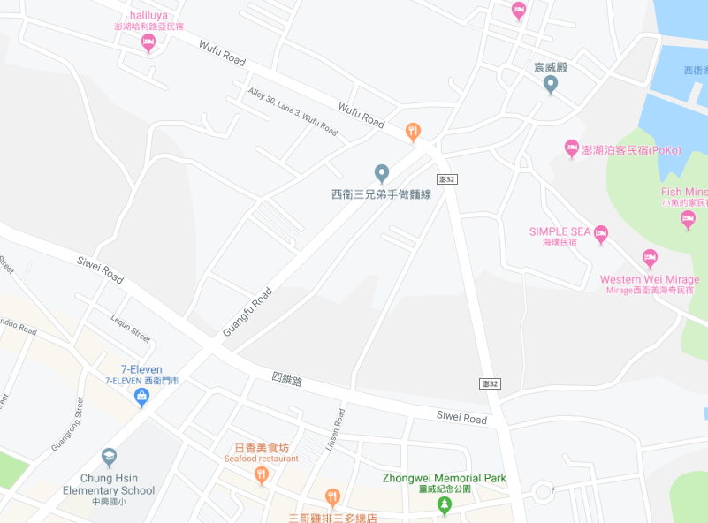




















Penghu County Magong City Xiwei Village Evacuation Map
Disaster Prevention Information
Emergency Notification Unit
Penghu Emergency Operation Center TEL:06-9277619 Magong City Emergency Operation Center TEL:06-9272173 Guangming Police Station TEL:06-9272542 Magong Fire Station TEL:06-9272137
Evacuation Principle
Flood:Stay away from low-lying area or go to evacuation shelter. Earthquake:Go to open space or evacuation shelter. Tsunami:Stay away from coastal low-lying area and take refuge in the nearby highland.
Evacuation Shelter
Name | Penghu University of Science and Technology
Area | 1,300 m2
Capacity | 325 people
Address | No. 300, Liuhe Rd., Magong City
TEL | 06-9278912
Name | Penghu County Government Fire Bureau Square
Area | 1,000 m²
Capacity | 250 people
Name | Xiwei Community Activity Center
Area | 506 m²
Capacity | 126 people
Address | No. 157-8, Xiwei, Magong City
TEL | 06-9273103
Made in March 2023 by Magong City Office, Penghu County
Xiwei Village
Xiwei Community Activity Center
Xiwei Park
Penghu County Government Fire Bureau
Penghu County Government Fire Bureau Square
Penghu University of Science and Technology
Legend | Labelling |  | Facility
 | Evacuation Route | Shelter for Flood | Indoor Evacuation Shelter | Park | Medical Facility
 | Flooded Area | Shelter for Earthquake | Outdoor Evacuation Shelter | Police Department
 | Continuous Monitored Area | Shelter for Tsunami | Helipad | Fire Department

