Slide 1
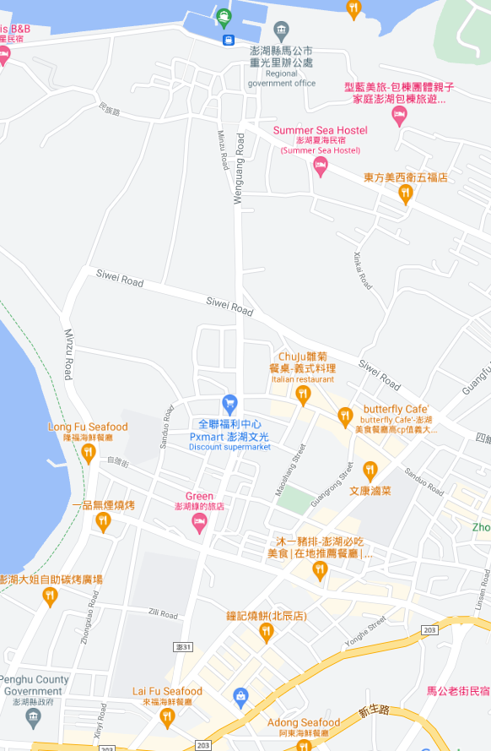


















Penghu County Magong City Chongguang Village Evacuation Map
Disaster Prevention Information
Emergency Notification Unit
Penghu Emergency Operation Center TEL:06-9277619 Magong City Emergency Operation Center TEL:06-9272173 Guangming Police Station TEL:06-9272542 Magong Fire Station TEL:06-9272137
Evacuation Principle
Flood:Stay away from low-lying area or go to evacuation shelter. Earthquake:Go to open space or evacuation shelter. Tsunami:Stay away from coastal low-lying area and take refuge in the nearby highland.
Evacuation Shelter
Name | Chongguang Community Activity Center
Area | 290 m²
Capacity | 72 people
Address | No.52, Chongguang,Magong City
TEL | 06-9273102
Name | Penghu County Government Fire Bureau Square
Area | 1,000 m²
Capacity | 250 people
Made in March 2023 by Magong City Office, Penghu County
Chongguang Community Activity Center
Chongguang Village
Penghu County Government Fire Bureau
Guangrong Park
Penghu County Government Fire Bureau Square
Qianxi Park
Guangming Police Bureau
Legend | Labelling |  | Facility
 | Evacuation Route | Shelter for Flood | Indoor Evacuation Shelter | Park | Medical Facility
 | Flooded Area | Shelter for Earthquake | Outdoor Evacuation Shelter | Police Department
 | Continuous Monitored Area | Shelter for Tsunami | Helipad | Fire Department

