Slide 1
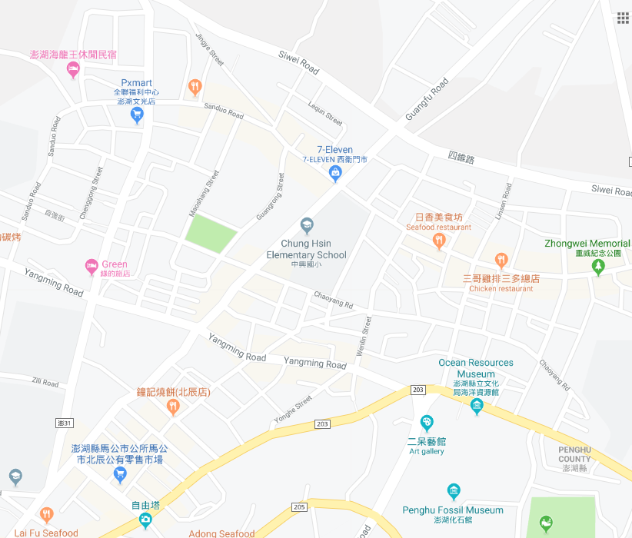




















Penghu County Magong City Yangming Village Evacuation Map
Disaster Prevention Information
Emergency Notification Unit
Penghu Emergency Operation Center TEL:06-9277619 Magong City Emergency Operation Center TEL:06-9272173 Guangming Police Station TEL:06-9272542 Magong Fire Station TEL:06-9272137
Evacuation Principle
Flood:Stay away from low-lying area or go to evacuation shelter. Earthquake:Go to open space or evacuation shelter. Tsunami:Stay away from coastal low-lying area and take refuge in the nearby highland.
Evacuation Shelter
Name | Zhongxing Elementary School
Area | 300 m²
Capacity | 75 people
Address | No.186, Guangfu Rd., Magong City
TEL | 06-9272779
Name | Wenguang Junior High School
Area | 1,000 m²
Capacity | 250 people
Address | No. 17, Wenguang Rd., Magong City
TEL | 06-9272992
Name | Magong Elementary School
Area | 400 m²
Capacity | 100 people
Address | No. 2, Mingyuan Rd., Magong City
TEL | 06-9272165
Made in March 2023 by Magong City Office, Penghu County
Yangming Village
Zhongxing Elementary School
Guangrong Park
Zhongwei Memorial Park
Qianxi Park
Wenguang Junior High School
Guangming Police Bureau
Magong Elementary School
Legend | Labelling |  | Facility
 | Evacuation Route | Shelter for Flood | Indoor Evacuation Shelter | Park | Medical Facility
 | Flooded Area | Shelter for Earthquake | Outdoor Evacuation Shelter | Police Department
 | Continuous Monitored Area | Shelter for Tsunami | Helipad | Fire Department

