Slide 1
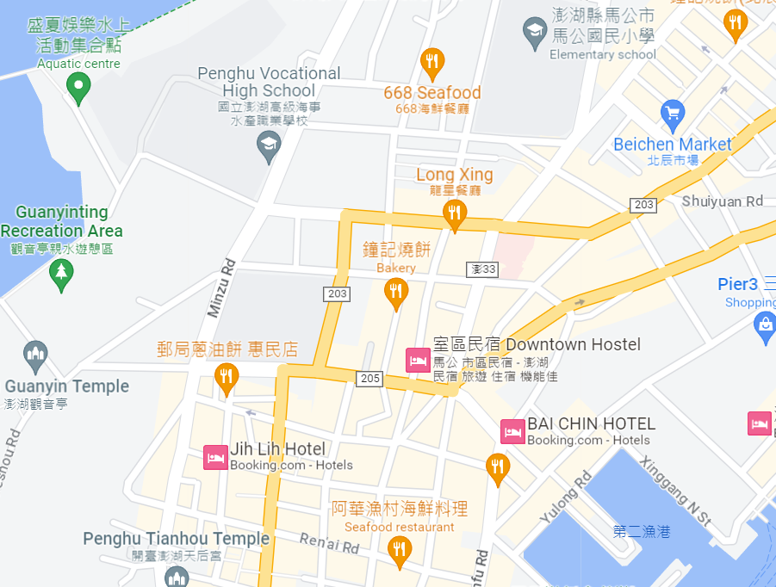




















Penghu County Magong City Zhongxing Village Evacuation Map
Disaster Prevention Information
Emergency Notification Unit
Penghu Emergency Operation Center TEL:06-9277619 Magong City Emergency Operation Center TEL:06-9272173 Qiming Police Station TEL:06-9272541 Magong Fire Station TEL:06-9272137
Evacuation Principle
Flood:Stay away from low-lying area or go to evacuation shelter. Earthquake:Go to open space or evacuation shelter. Tsunami:Stay away from coastal low-lying area and take refuge in the nearby highland.
Evacuation Shelter
Name | Zhongzheng Elementary School
Area | 600 m²
Capacity | 150 people
Address | No. 38, Minsheng Rd., Magong City
TEL | 06-9272758
Name | Magong Elementary School
Area | 400 m²
Capacity | 100 people
Address | No. 2, Mingyuan Rd., Magong City
TEL | 06-9272165
Made in March 2023 by Magong City Office, Penghu County
Magong Elementary School
Penghu County Government Police Bureau
Zhongxing Village
The first Health Center of Mangong City
Xiangdui Park
ST. CAMILLUS HOSPITAL
Zhongzheng Elementary School
Guanyinting
Legend | Labelling |  | Facility
 | Evacuation Route | Shelter for Flood | Indoor Evacuation Shelter | Park | Medical Facility
 | Flooded Area | Shelter for Earthquake | Outdoor Evacuation Shelter | Police Department
 | Continuous Monitored Area | Shelter for Tsunami | Helipad | Fire Department

