Slide 1
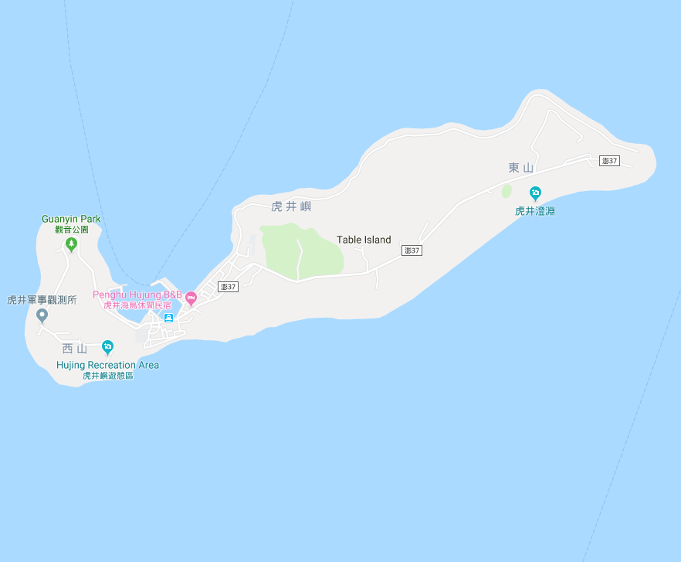




















Penghu County Magong City Hujing Village Evacuation Map
Disaster Prevention Information
Emergency Notification Unit
Penghu Emergency Operation Center TEL:06-9277619 Magong City Emergency Operation Center TEL:06-9272173 Hujing Police Station TEL:06-9291112 Hujing Fire Station TEL:06-9291226
Evacuation Principle
Flood:Stay away from low-lying area or go to evacuation shelter. Earthquake:Go to open space or evacuation shelter. Tsunami:Stay away from coastal low-lying area and take refuge in the nearby highland.
Evacuation Shelter
Name | Hujing Community Activity Center
Area | 566 m²
Capacity | 140 people
Address | No. 9-2, Hujing, Magong City
TEL | 06-9291066
Name | Highland
Area | 4,000m²
Capacity | 1,000 people
Name | Highland
Area | 4,000m²
Capacity | 1,000 people
Made in March 2022 by Magong City Office, Penghu County
Highland
Hujing Village
Hujing Public Health Center
Hujing Fire Station
Helipad
Hujing Police Station
Highland
Hujing Community
Activity Center
Legend | Labelling |  | Facility
 | Evacuation Route | Shelter for Flood | Indoor Evacuation Shelter | Park | Medical Facility
 | Flooded Area | Shelter for Earthquake | Outdoor Evacuation Shelter | Police Department
 | Continuous Monitored Area | Shelter for Tsunami | Helipad | Fire Department

