Slide 1
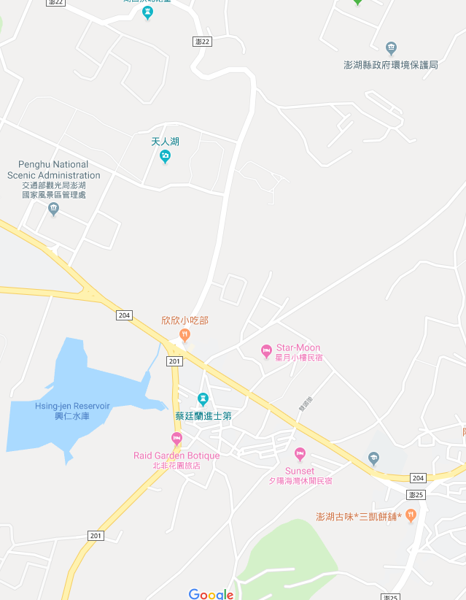













Penghu County Magong City Xingren Village Evacuation Map
Disaster Prevention Information
Emergency Notification Unit
Penghu Emergency Operation Center TEL:06-9277619 Magong City Emergency Operation Center TEL:06-9272173 Dongwei Police Station TEL:06-9211318 Magong Fire Station TEL:06-9272137
Evacuation Principle
Flood:Stay away from low-lying area or go to evacuation shelter. Earthquake:Go to open space or evacuation shelter. Tsunami:Stay away from coastal low-lying area and take refuge in the nearby highland.
Evacuation Shelter
Name | Square
Area | 4,000 m²
Capacity | 1,000 people
Name | Xingren Elementary School
Area | 600 m²
Capacity | 150 people
Address | No. 129, Wukan, Magong City
TEL | 06-9211443
Name | Xingren Community Activity Center
Area | 110 m²
Capacity | 25 people
Address | No. 47, Xingren, Magong City
TEL | 06-9210260
Made in March 2022 by Magong City Office, Penghu County
Square
Xingren Village
Xingren Community Activity Center
Xingren Elementary School
Legend | Labelling |  | Facility
 | Evacuation Route | Shelter for Flood | Indoor Evacuation Shelter | Park | Medical Facility
 | Flooded Area | Shelter for Earthquake | Outdoor Evacuation Shelter | Police Department
 | Continuous Monitored Area | Shelter for Tsunami | Helipad | Fire Department

