Slide 1

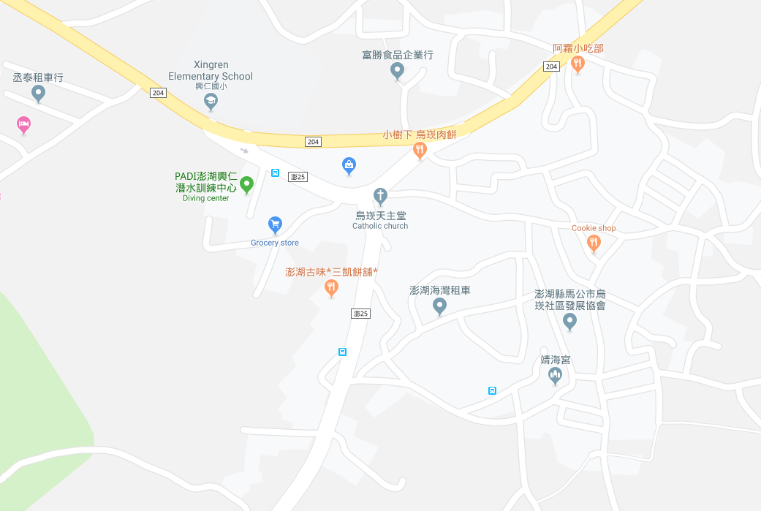
















Penghu County Magong City Wukan Village Evacuation Map
Disaster Prevention Information
Emergency Notification Unit
Penghu Emergency Operation Center TEL:06-9277619 Magong City Emergency Operation Center TEL:06-9272173 Dongwei Police Station TEL:06-9211318 Pengnan Fire Station TEL:06-9950119
Evacuation Principle
Flood:Stay away from low-lying area or go to evacuation shelter. Earthquake:Go to open space or evacuation shelter. Tsunami:Stay away from coastal low-lying area and take refuge in the nearby highland.
Evacuation Shelter
Name | Xingren Elementary School
Area | 600 m²
Capacity | 150 people
Address | No. 129, Wukan, Magong City
TEL | 06-9211443
Name | Wukan Community Activity Center
Area | 200 m²
Capacity | 50 people
Address | No. 71-10, Wukan, Magong City
TEL | 06-9215707
Made in March 2022 by Magong City Office, Penghu County
Zhongzheng Junior High School
Shiquan Elementary School
Xingren Elementary School
Wukan Village
Wukan Village
菜園里澎205號道路側空地
Wukan Community Activity Center
Legend | Labelling |  | Facility
 | Evacuation Route | Shelter for Flood | Indoor Evacuation Shelter | Park | Medical Facility
 | Flooded Area | Shelter for Earthquake | Outdoor Evacuation Shelter | Police Department
 | Continuous Monitored Area | Shelter for Tsunami | Helipad | Fire Department

