Slide 1
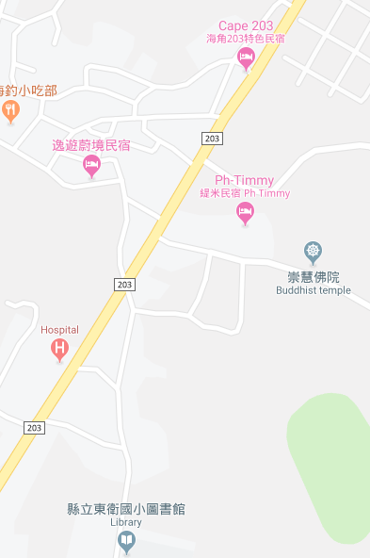













Penghu County Magong City Anzhai Village Evacuation Map
Disaster Prevention Information
Emergency Notification Unit
Penghu Emergency Operation Center TEL:06-9277619 Magong City Emergency Operation Center TEL:06-9272173 Dongwei Police Station TEL:06-9211318 Magong Fire Station TEL:06-9272137
Evacuation Principle
Flood:Stay away from low-lying area or go to evacuation shelter. Earthquake:Go to open space or evacuation shelter. Tsunami:Stay away from coastal low-lying area and take refuge in the nearby highland.
Evacuation Shelter
Name | Highland
Area | 1,000 m²
Capacity | 250 people
Name | Anzhai Community Activity Center
Area | 190 m²
Capacity | 45 people
Address | No. 6-6, Anzhai, Magong City
TEL | 06-9215820
Name | Dongwei Elementary School
Area | 620 m²
Capacity | 155 people
Address | No. 169, Dongwei, Magong City
TEL | 06-9213238
Made in March 2022 by Magong City Office, Penghu County
Highland
Anzhai Community Activity Center
Anzhai Village
Dongwei Elementary School
Legend | Labelling |  | Facility
 | Evacuation Route | Shelter for Flood | Indoor Evacuation Shelter | Park | Medical Facility
 | Flooded Area | Shelter for Earthquake | Outdoor Evacuation Shelter | Police Department
 | Continuous Monitored Area | Shelter for Tsunami | Helipad | Fire Department

