Slide 1
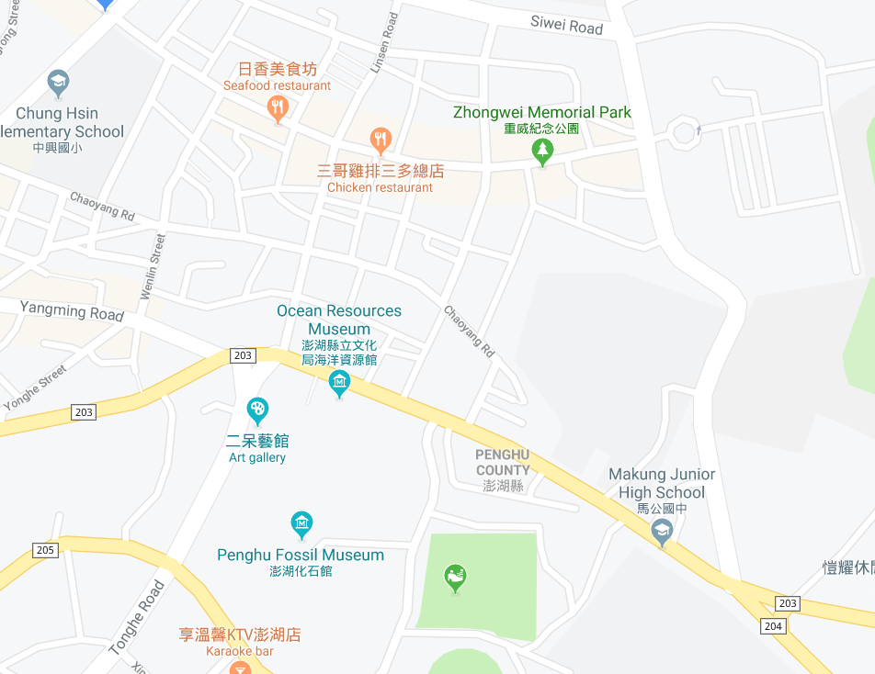



















Penghu County Magong City Chaoyang Village Evacuation Map
Disaster Prevention Information
Emergency Notification Unit
Penghu Emergency Operation Center TEL:06-9277619 Magong City Emergency Operation Center TEL:06-9272173 Guangming Police Station TEL:06-9272542 Magong Fire Station TEL:06-9272137
Evacuation Principle
Flood:Stay away from low-lying area or go to evacuation shelter. Earthquake:Go to open space or evacuation shelter. Tsunami:Stay away from coastal low-lying area and take refuge in the nearby highland.
Evacuation Shelter
Name | Zhongxing Elementary School
Area | 300 m²
Capacity | 75 people
Address | No.186, Guangfu Rd., Magong City
TEL | 06-9272779
Name | Chaoyang Community Activity Center
Area | 223 m²
Capacity | 55 people
Address | No. 18, Ln. 21, Liuhe Rd., Magong City
TEL | 06-9266903
Name | Penghu University of Science and Technology
Area | 1,300 m²
Capacity | 325 people
Address | No. 300, Liuhe Rd., Magong City
TEL | 06-9264115
Name | Magong High School
Area | 500m²
Capacity | 125people
Address | No. 369, Zhonghua Rd., Magong City
TEL | 06-9272342
Made in March 2022 by Magong City Office, Penghu County
Zhongxing Elementary School
Penghu University of Science and Technology
Qianxi Park
Chaoyang Community Activity Center
Chaoyang Village
Magong High School
Guangming Police Bureau
Legend | Labelling |  | Facility
 | Evacuation Route | Shelter for Flood | Indoor Evacuation Shelter | Park | Medical Facility
 | Flooded Area | Shelter for Earthquake | Outdoor Evacuation Shelter | Police Department
 | Continuous Monitored Area | Shelter for Tsunami | Helipad | Fire Department

