Slide 1
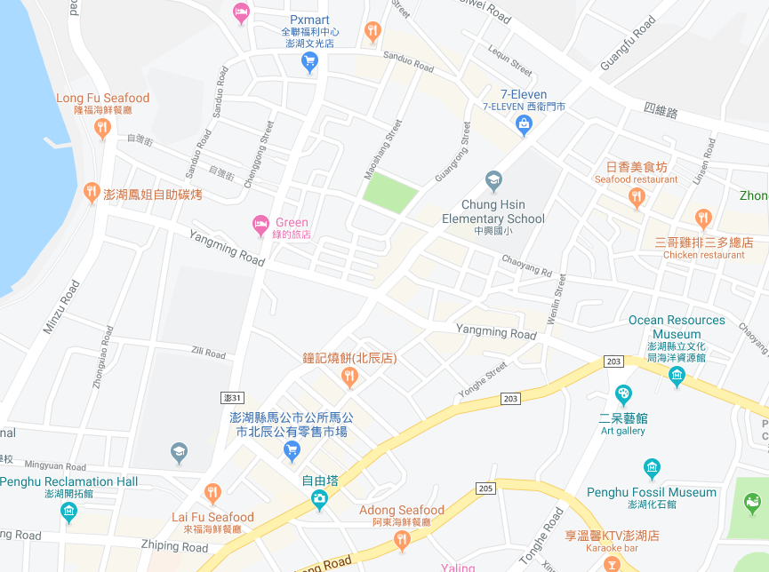

























Penghu County Magong City Guangming Village Evacuation Map
Disaster Prevention Information
Emergency Notification Unit
Penghu Emergency Operation Center TEL:06-9277619 Magong City Emergency Operation Center TEL:06-9272173 Guangming Police Station TEL:06-9272542 Magong Fire Station TEL:06-9272137
Evacuation Principle
Flood:Stay away from low-lying area or go to evacuation shelter. Earthquake:Go to open space or evacuation shelter. Tsunami:Stay away from coastal low-lying area and take refuge in the nearby highland.
Evacuation Shelter
Name | Wenguang Junior High School
Area | 1,000 m²
Capacity | 250 people
Address | No. 17, Wenguang Rd., Magong City
TEL | 06-9272992
Name | Special Education Complex
Area | 500 m²
Capacity | 125 people
Address | No. 21, Zili Road, Magong City
TEL | 06-9267902
Name | Special Education Complex Square
Area | 1,000 m²
Capacity | 250 people
Made in March 2022 by Magong City Office, Penghu County
Guangming Village
Guangrong Park
Wenguang Junior High School
Qianxi Park
Special Education Complex Square
Special Education Complex
Guangming Police Bureau
Legend | Labelling |  | Facility
 | Evacuation Route | Shelter for Flood | Indoor Evacuation Shelter | Park | Medical Facility
 | Flooded Area | Shelter for Earthquake | Outdoor Evacuation Shelter | Police Department
 | Continuous Monitored Area | Shelter for Tsunami | Helipad | Fire Department

