Slide 1
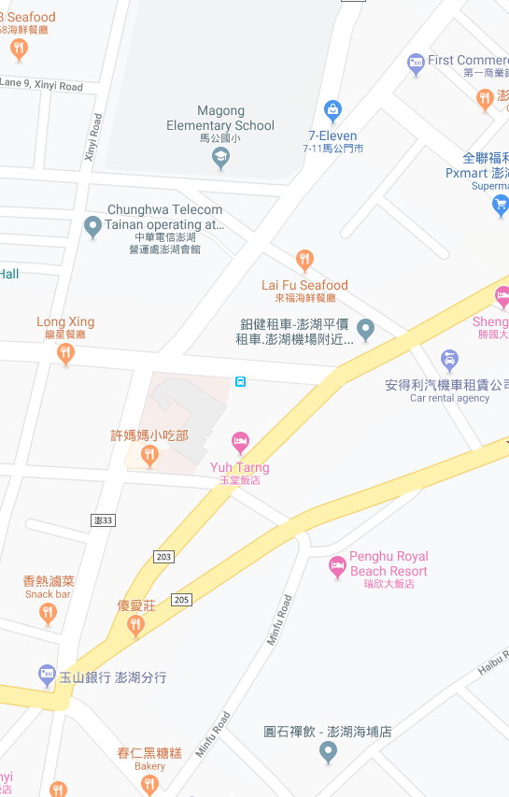















Penghu County Magong City Guangfu Village Evacuation Map
Disaster Prevention Information
Emergency Notification Unit
Penghu Emergency Operation Center TEL:06-9277619 Magong City Emergency Operation Center TEL:06-9272173 Qiming Police Station TEL:06-9272541 Magong Fire Station TEL:06-9272137
Evacuation Principle
Flood:Stay away from low-lying area or go to evacuation shelter. Earthquake:Go to open space or evacuation shelter. Tsunami:Stay away from coastal low-lying area and take refuge in the nearby highland.
Evacuation Shelter
Name | Magong Elementary School
Area | 400 m²
Capacity | 100 people
Address | No. 2, Mingyuan Rd., Magong City
TEL | 06-9272165
Made in March 2022 by Magong City Office, Penghu County
Magong Elementary School
Guangfu Village
ST. CAMILLUS HOSPITAL
Legend | Labelling |  | Facility
 | Evacuation Route | Shelter for Flood | Indoor Evacuation Shelter | Park | Medical Facility
 | Flooded Area | Shelter for Earthquake | Outdoor Evacuation Shelter | Police Department
 | Continuous Monitored Area | Shelter for Tsunami | Helipad | Fire Department

