Slide 1

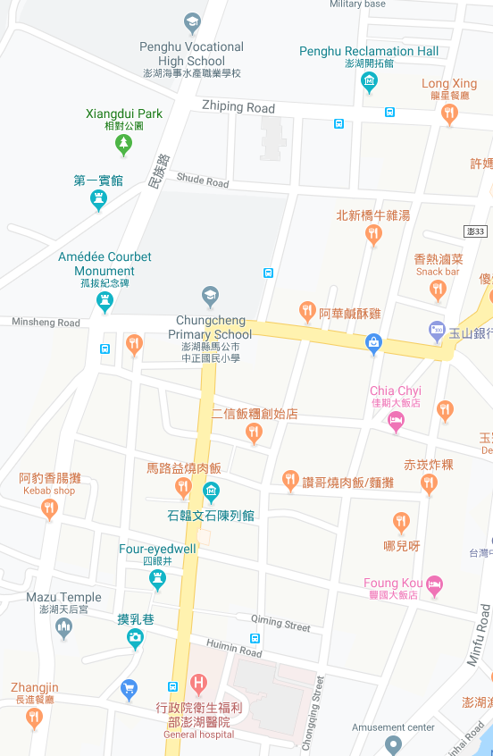
















Penghu County Magong City Chongqing Village Evacuation Map
Disaster Prevention Information
Emergency Notification Unit
Penghu Emergency Operation Center TEL:06-9277619 Magong City Emergency Operation Center TEL:06-9272173 Qiming Police Station TEL:06-9272541 Magong Fire Station TEL:06-9272137
Evacuation Principle
Flood:Stay away from low-lying area or go to evacuation shelter. Earthquake:Go to open space or evacuation shelter. Tsunami:Stay away from coastal low-lying area and take refuge in the nearby highland.
Evacuation Shelter
Name | Zhongzheng Elementary School
Area | 600 m²
Capacity | 150 people
Address | No. 38, Minsheng Rd., Magong City
TEL | 06-9272758
Name | Penghu County Government
Area | 400 m²
Capacity | 100 people
Address | No. 32, Zhiping Rd., Magong City
TEL | 06-9274400
Name | Penghu County Government Police Bureau
Area | 400 m²
Capacity | 100 people
Address | No. 36, Zhiping Rd., Magong City
TEL | 06-9272105
Made in March 2022 by Magong City Office, Penghu County
Penghu County Government
Penghu County Government Police Bureau
Xiangdui Park
The first Health Center of Mangong City
Zhongzheng Elementary School
Chongqing Village
Penghu Hospital, Ministry of Health and Welfare
Legend | Labelling |  | Facility
 | Evacuation Route | Shelter for Flood | Indoor Evacuation Shelter | Park | Medical Facility
 | Flooded Area | Shelter for Earthquake | Outdoor Evacuation Shelter | Police Department
 | Continuous Monitored Area | Shelter for Tsunami | Helipad | Fire Department

