Slide 1

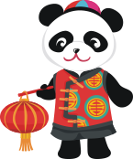

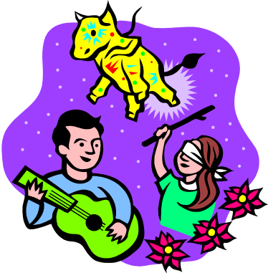
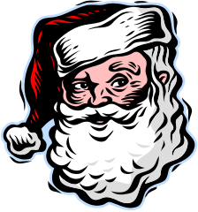

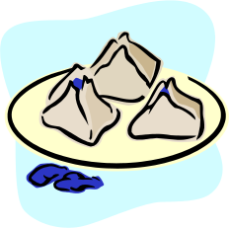
Session 1 ☺
Festivals

Slide 2
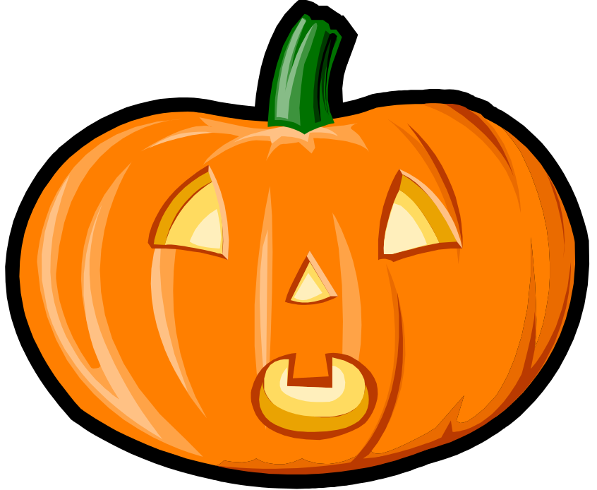
Halloween
**October 31st**

Slide 3
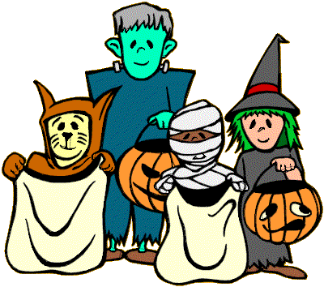
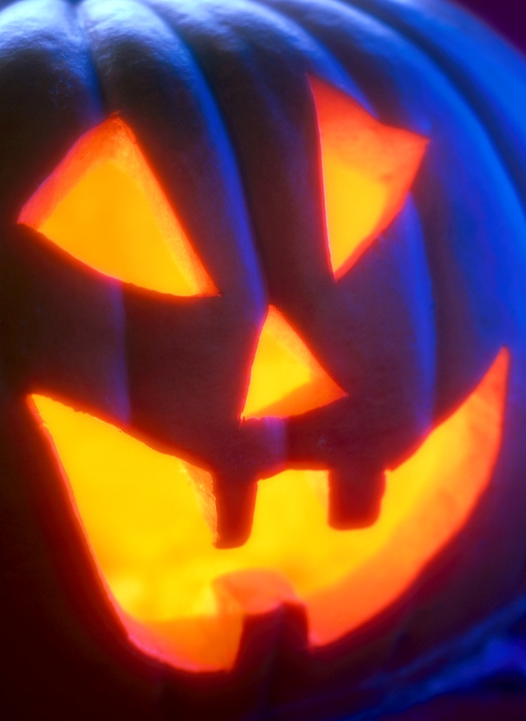
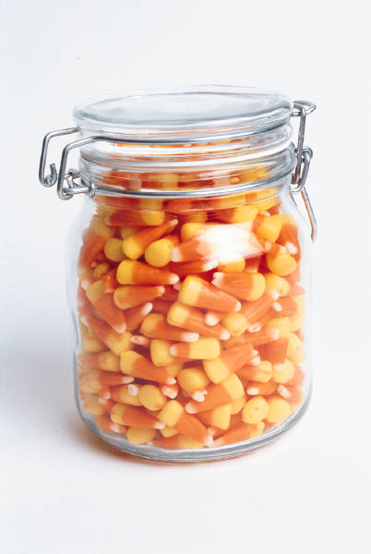
Happy Halloween!

Slide 4
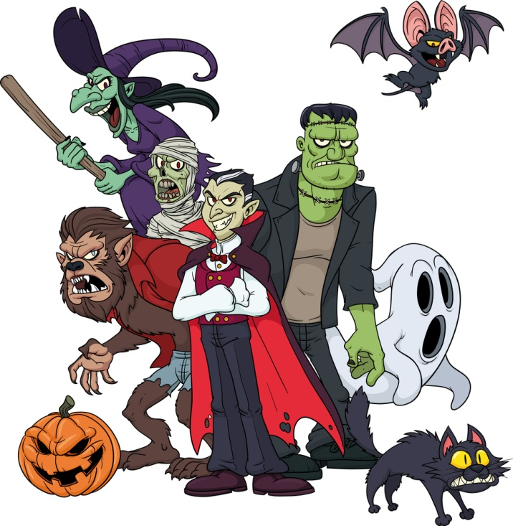
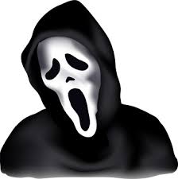
monster
Which will you choose?

Slide 5
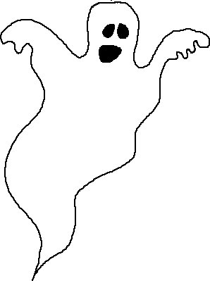
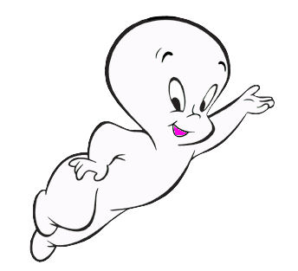

ghost

Slide 6

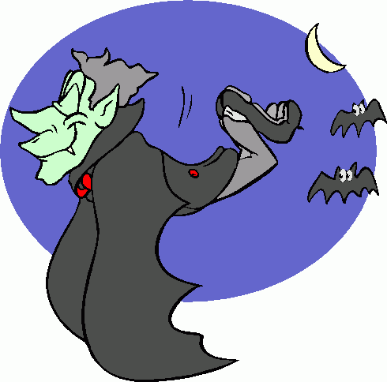
vampire

Slide 7
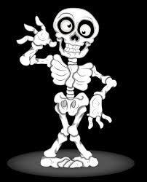
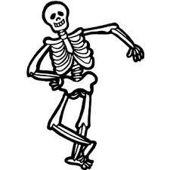
skeleton

Slide 8


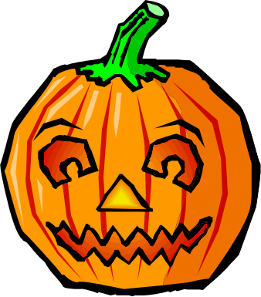
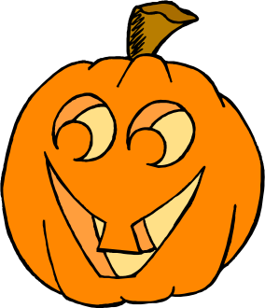


Five Little Pumpkins

Slide 9
Five little pumpkins
Sitting on the gate.

Slide 10
The first one said:
Oh my!
It’s getting late!

Slide 11
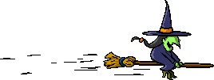
The second one said:
There are witches in the air!

Slide 12
The third one said:
But we don’t care!

Slide 13
The fourth one said:
Let’s run and run and run!

Slide 14

The fifth one said:
I’m ready for some fun!

Slide 15

“Ooooh!” went the wind.

Slide 16
And out went the light!

Slide 17
And the five little pumpkins rolled out of sight!

Slide 18



Slide 19
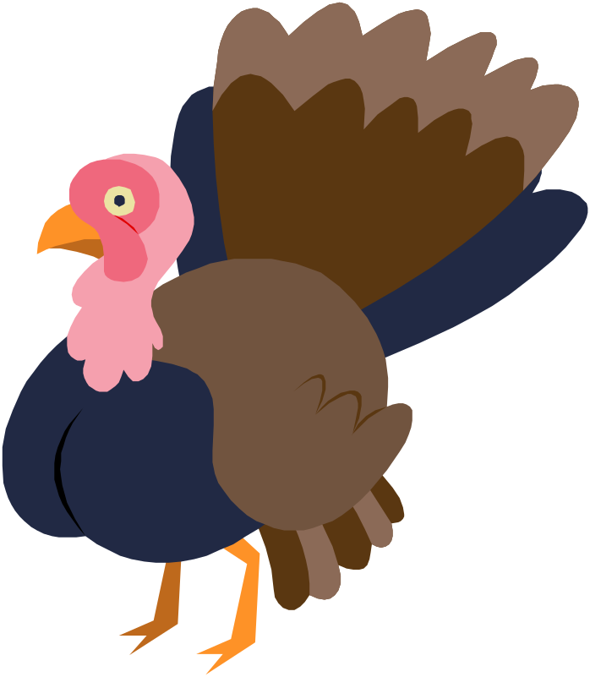
Thanksgiving
**November 28th**

Slide 20
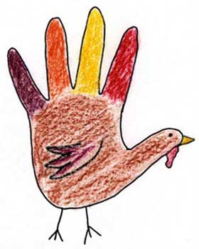
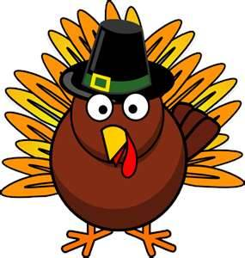
Thanksgiving
Traditions
2012

Slide 21
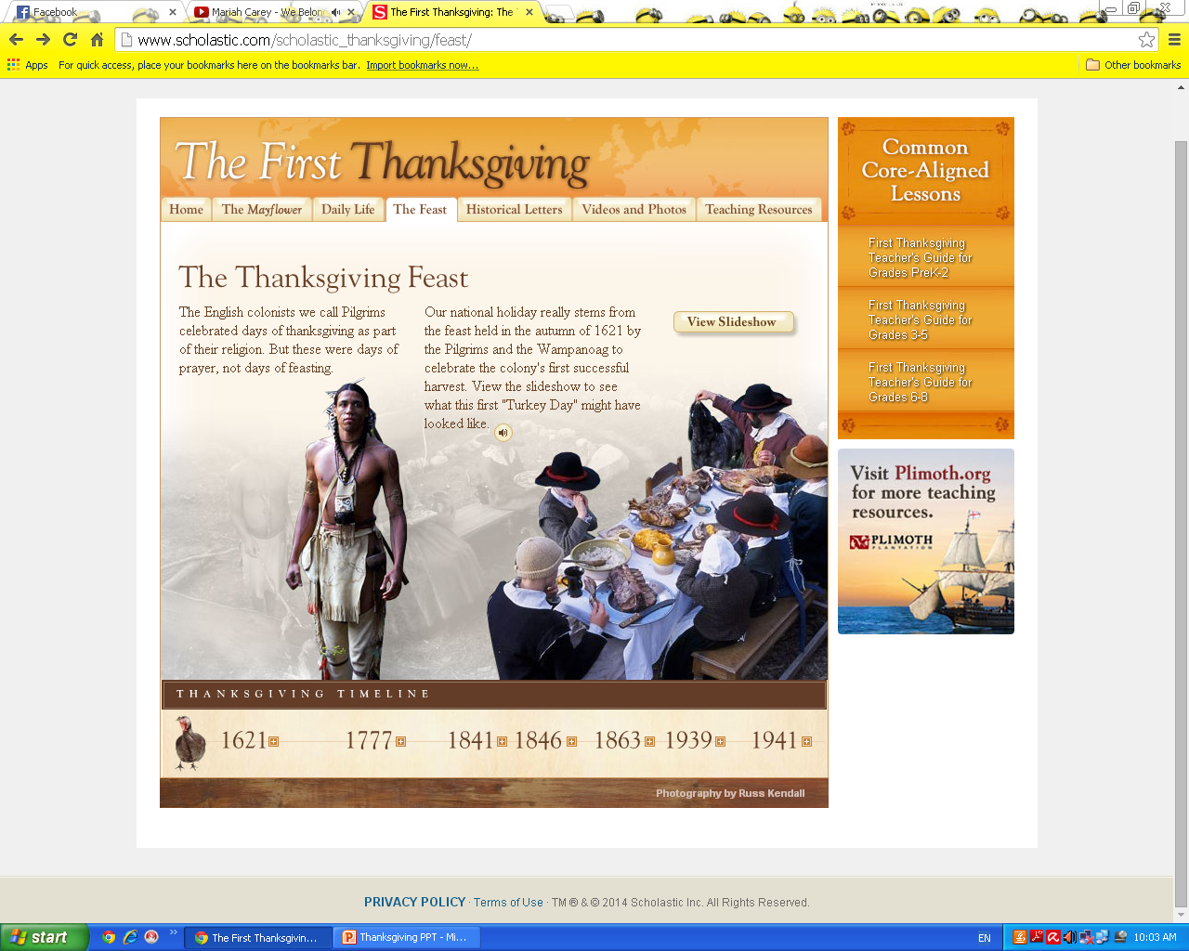
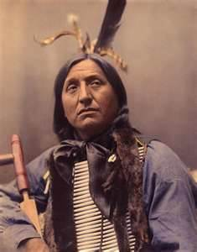
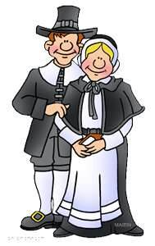
American Holiday
First Thanksgiving
Native Americans
Pilgrims
Eat Fall Harvest

Slide 22
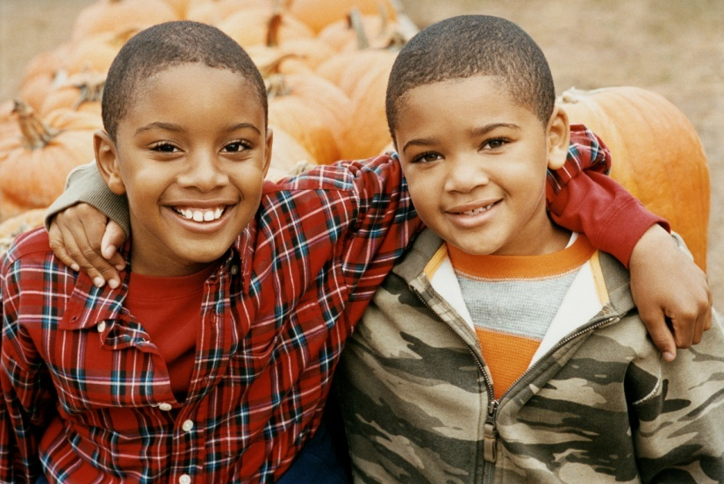
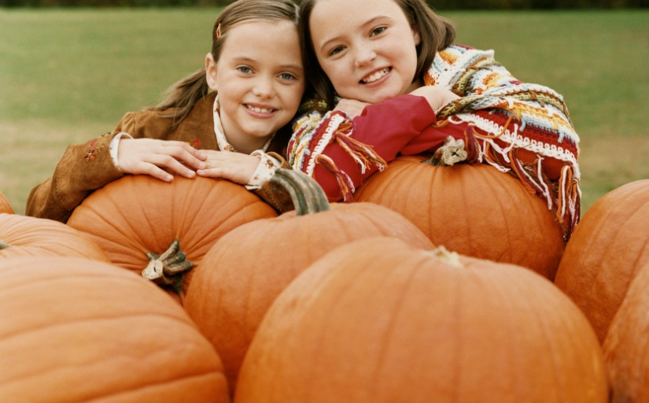
Thanksgiving
Focus
Family
Food
Thanks

Slide 23
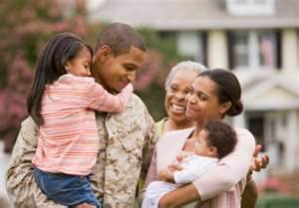

Family
Families return home for this day.
No school/ work for Thursday, Friday, Saturday, and Sunday.

Slide 24
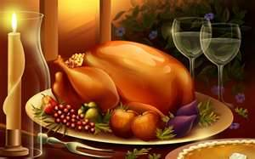
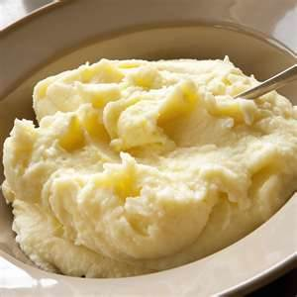
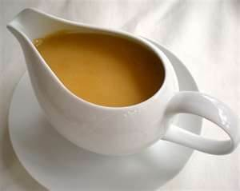
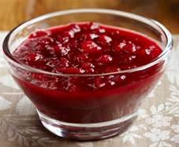
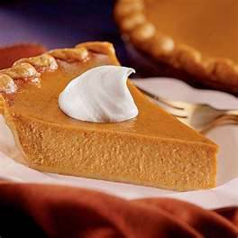
Food
Traditional Foods are:
  Turkey
  Mashed Potatoes
  Gravy
  Cranberry Sauce
  Pumpkin Pie

Slide 25
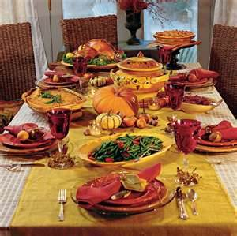
Thanksgiving Dinner

Slide 26
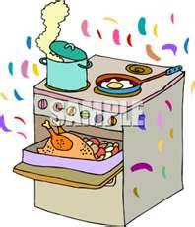
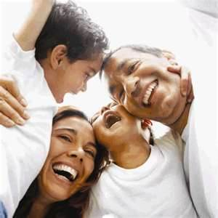
Daily Activities
Get up early and put turkey in oven
Family arrives

Slide 27
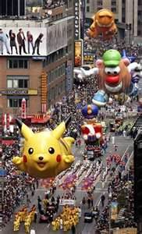
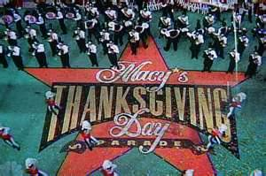
Daily Activities
Watch Macy Day Parade

Slide 28
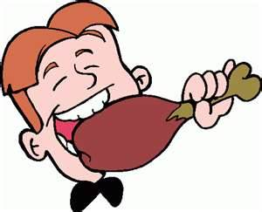
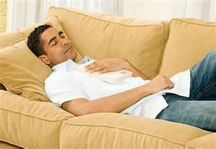
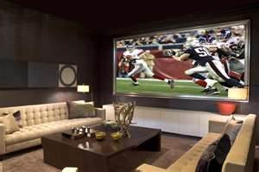
Daily Activities
Eat
Nap
Watch Football

Slide 29
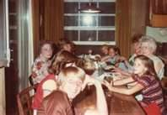
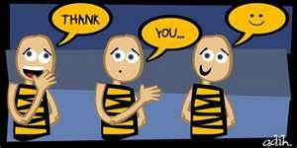
Give Thanks
Go around table and say what we are thankful for.
What are you thankful for?

Slide 30
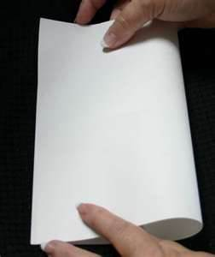
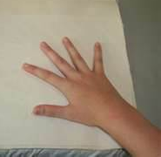
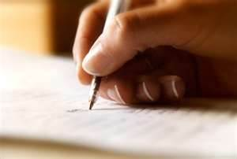

Make a Thanksgiving Card
Fold the paper
Trace hand
Make turkey
Write poem
Complete sentence
Color

Slide 31
Copy Poem
This is not just a turkey,
As you can see.
I made it with my hand, this is a part of me!
I hope you have a
Happy Thanksgiving Day!
Love _________

Slide 32
Complete Sentence
I am thankful for……
my mom.
my dad.
my family.
my dog.
my teacher.
my friends.

Slide 33

Decorate the Thanksgiving Card
Color/Decorate your card
Read to teacher

Slide 34
I am thankful for you!

Slide 35
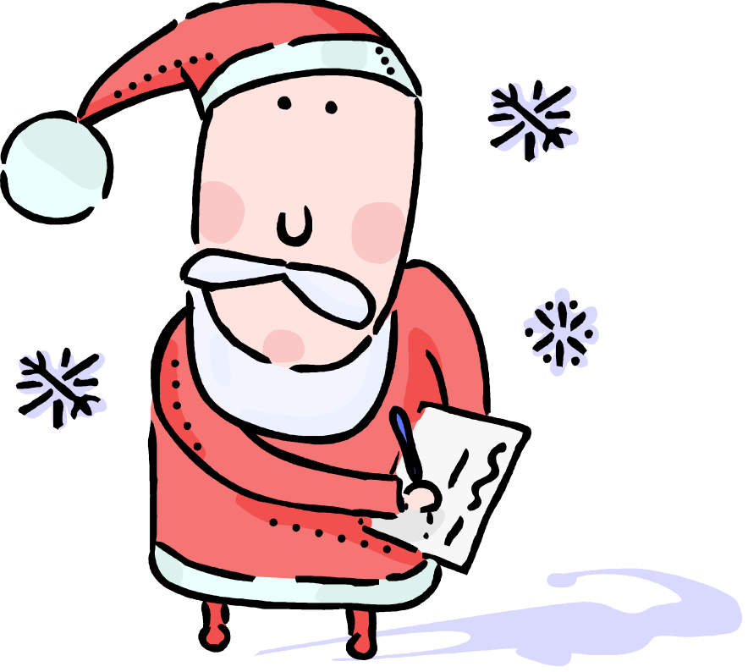
Christmas
*December 25th**

Slide 36
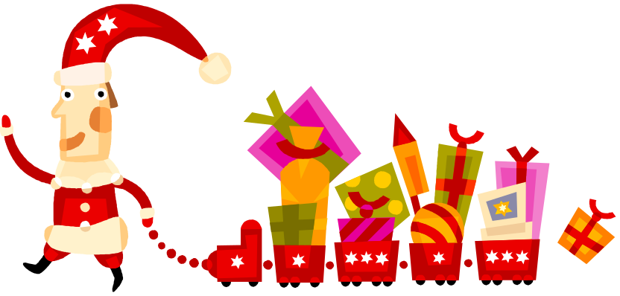

Christmas is a joyful time, where people are giving to others.
Students will enjoy singing fun jingles and ‘being merry’, reading bedtime Christmas stories (The Night Before Christmas)
Creating Christmas cards, secret Santa, making Christmas cookies

Slide 37
Christmas Vocabulary
Giving, presents, Santa Clause, reindeer, Christmas tree, jingle bells, snow, sleigh, gingerbread man, cookies, milk, holly, wreath, ornaments, snowman, etc..

Slide 38
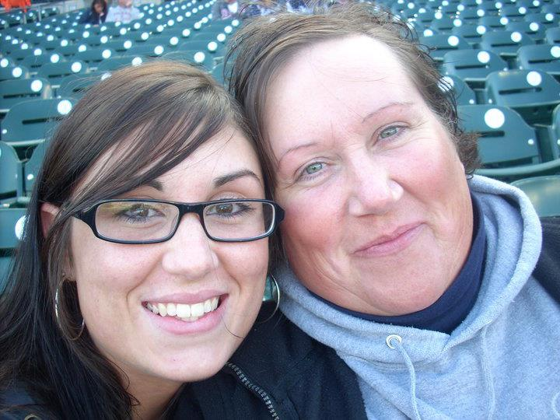
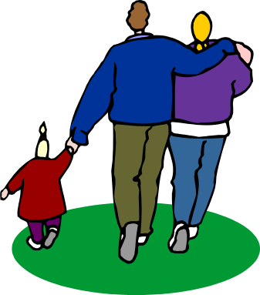
Mother’s/Father’s Day
**Mom’s day: 2nd Sunday in May, Dad’s day: Sunday, June 21st

Slide 39
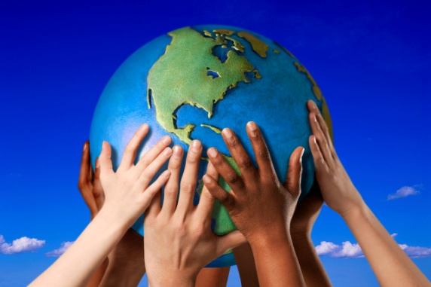




Every family is different…

Slide 40
Websites!!
http://www.eslgamesplus.com/christmas-vocabulary-memory-game-for-esl/
https://www.teachervision.com/december-holidays/teacher-resources/6609.html
http://pbskids.org/whiteboard/

Slide 41

Any questions??! ☺

