Slide 1
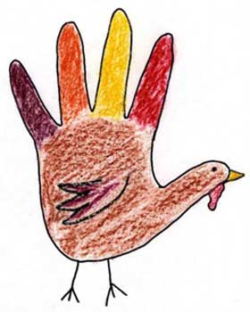
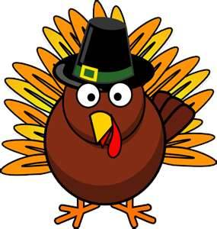
Thanksgiving
Traditions
2012

Slide 2
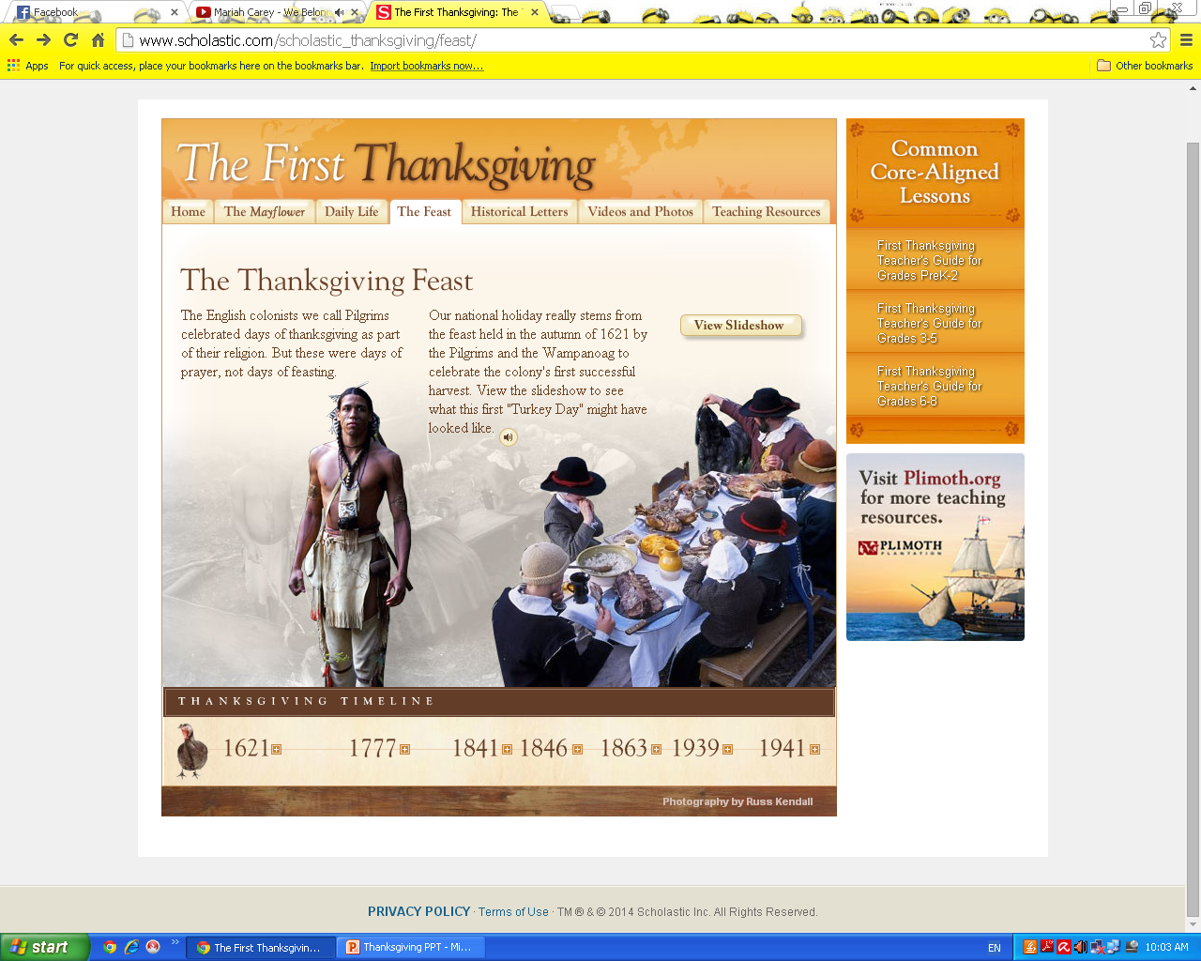
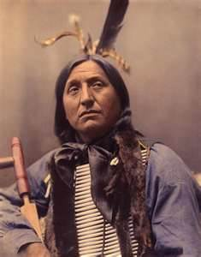
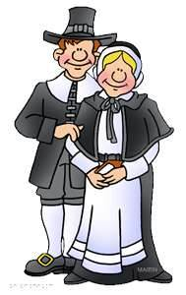
American Holiday
First Thanksgiving
Native Americans
Pilgrims
Eat Fall Harvest

Slide 3
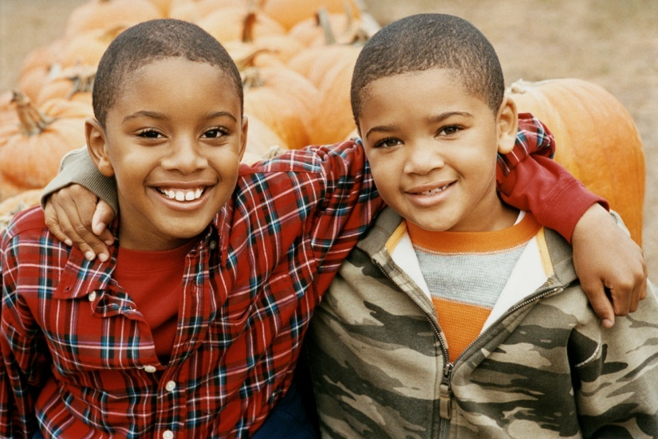
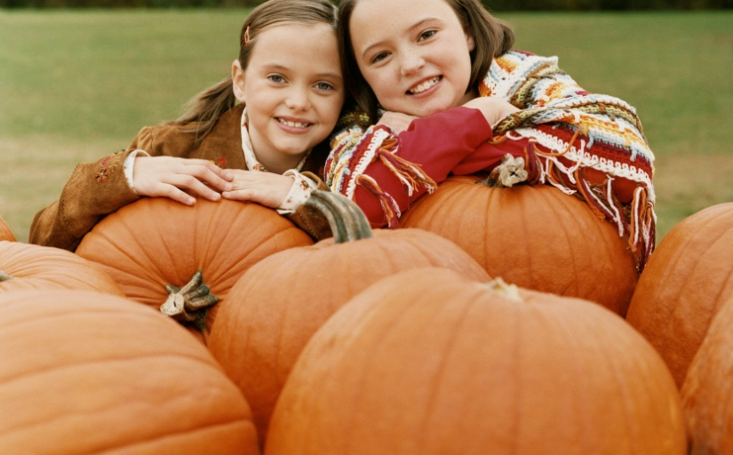
Thanksgiving
Focus
Family
Food
Thanks

Slide 4
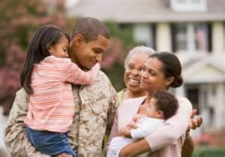

Family
Families return home for this day.
No school/ work for Thursday, Friday, Saturday, and Sunday.

Slide 5
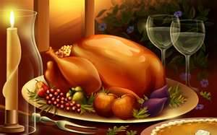
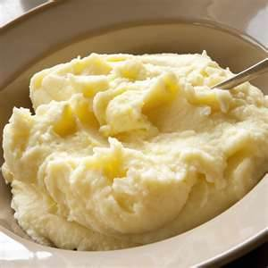
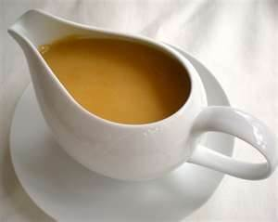
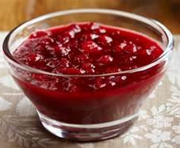
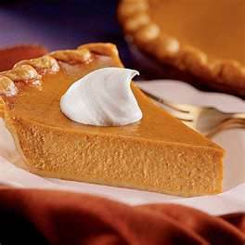
Food
Traditional Foods are:
  Turkey
  Mashed Potatoes
  Gravy
  Cranberry Sauce
  Pumpkin Pie

Slide 6
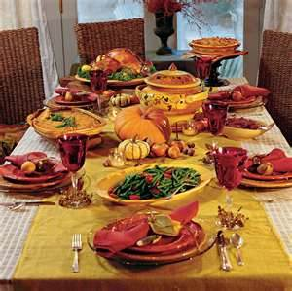
Thanksgiving Dinner

Slide 7
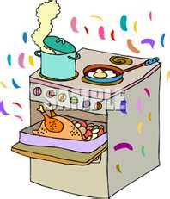
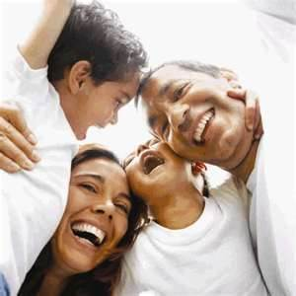
Daily Activities
Get up early and put turkey in oven
Family arrives

Slide 8
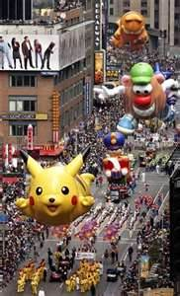
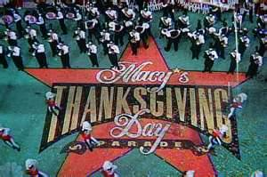
Daily Activities
Watch Macy Day Parade

Slide 9
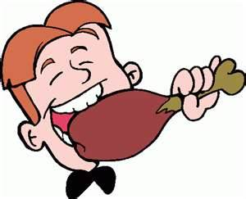
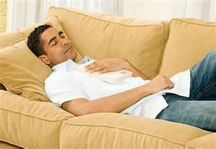
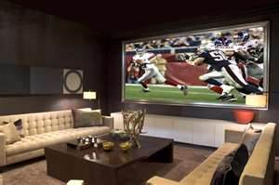
Daily Activities
Eat
Nap
Watch Football

Slide 10
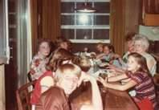
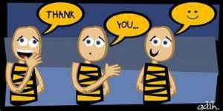
Give Thanks
Go around table and say what we are thankful for.
What are you thankful for?

Slide 11
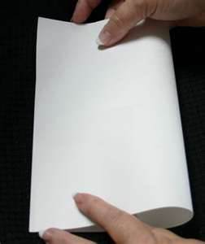
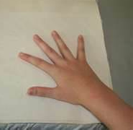
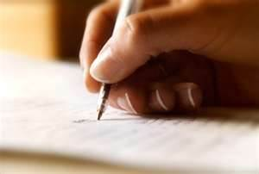

Make a Thanksgiving Card
Fold the paper
Trace hand
Make turkey
Write poem
Complete sentence
Color

Slide 12
Copy Poem
This is not just a turkey,
As you can see.
I made it with my hand, this is a part of me!
I hope you have a
Happy Thanksgiving Day!
Love _________

Slide 13
Complete Sentence
I am thankful for……
my mom.
my dad.
my family.
my dog.
my teacher.
my friends.

Slide 14

Decorate the Thanksgiving Card
Color/Decorate your card
Read to teacher

Slide 15
I am thankful for you!

Slide 16
Game
Crossword Puzzle

